Slide 1
Warmup slides:
Lecture 3
Fundamentals of Analytics and Discovery Informatics
16:137:550
Bryan Bischof 20200921

Slide 2
Bayes’ theorem
“In forming your plan for your future you need to distinguish three different questions:
What is possible?
What is likely to happen?
What is desirable to have happen?
” - Richard Hamming, Learning to Learn
This is true so too in Bayes’ theorem and–in fact–most of statistical science.

Slide 3
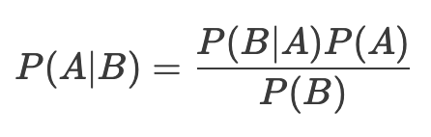
Statement of the theorem
Reminders:
P(A) == ‘probability of A being observed’
P(A|B) == ‘probability of A being observed assuming we have observed B’
P(A|B) == ‘probability of A given B’

Slide 4
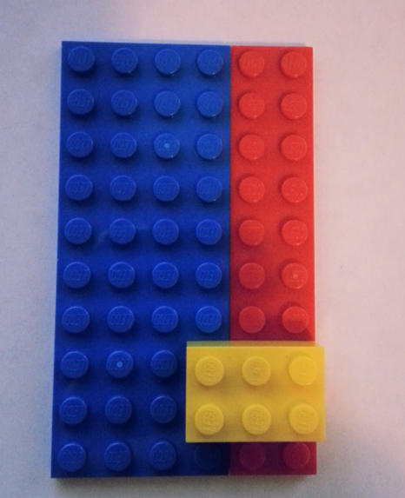




An interesting and very serious application…
We’re gonna compute some probabilities with these lego,
A few basic ones to get started:

Slide 5
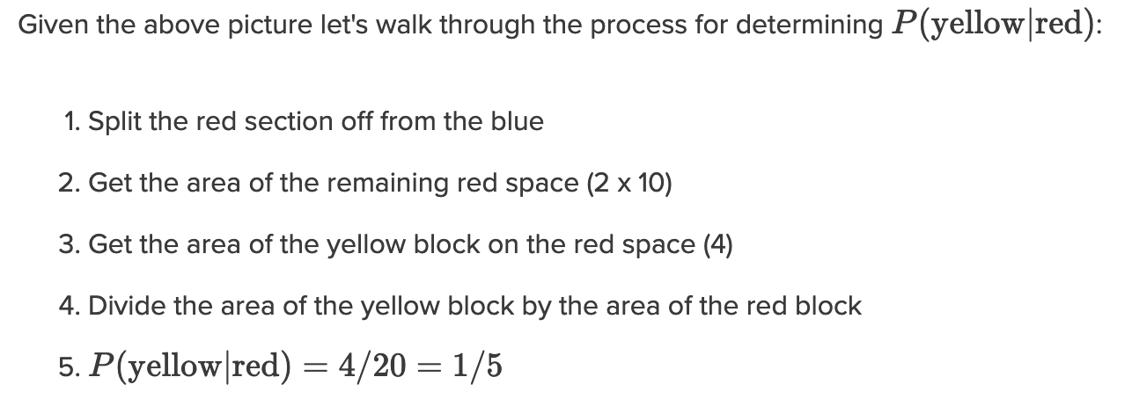
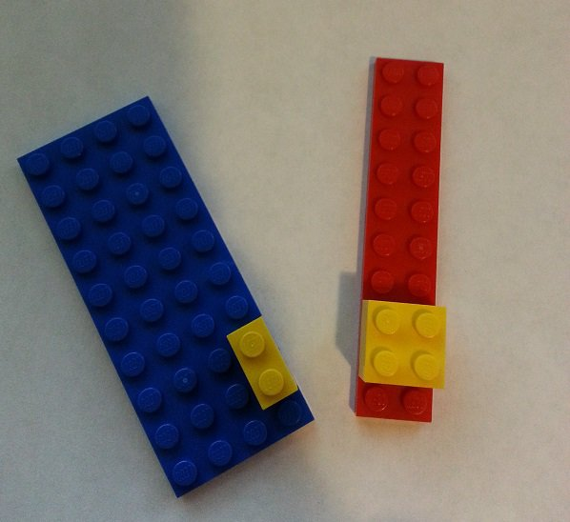
Conditionals

Slide 6
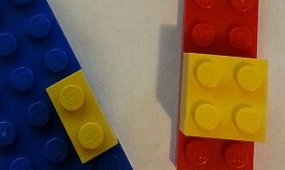
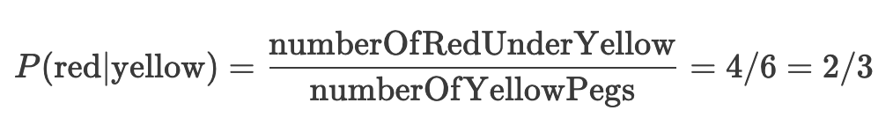
What we know

Slide 7
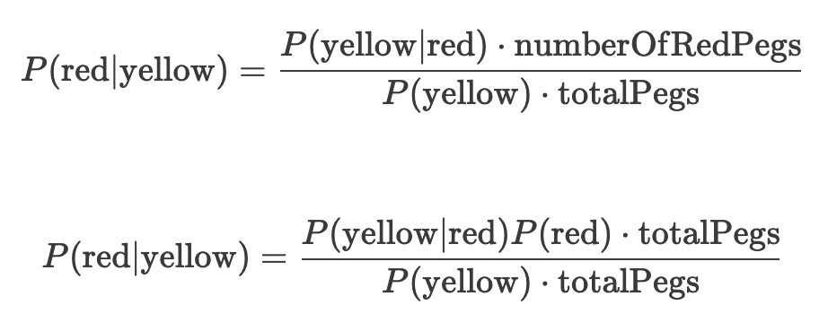
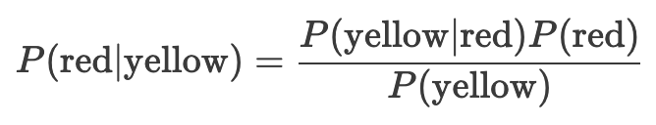
Back to Bayes

Slide 8
A Gaussian Normal
“THERE IS A story about two friends, who were classmates in high school, talking about their jobs. One of them became a statistician and was working on population trends. He showed a reprint to his former classmate. The reprint started, as usual, with the Gaussian distribution and the statistician explained to his former classmate the meaning of the symbols for the actual population, for the average population, and so on.
His classmate was a bit incredulous and was not quite sure whether the statistician was pulling his leg.
"How can you know that?" was his query. "And what is this symbol here?" "Oh," said the statistician, "this is pi." "What is that?" "The ratio of the circumference of the circle to its diameter."
"Well, now you are pushing your joke too far," said the classmate, "surely the population has nothing to do with the circumference of the circle." - Wigner, The Unreasonable Effectiveness of Mathematics

Slide 9
Some links
Bayes’ theorem with Lego
Richard Hamming's You and Your Research
Hamming’s Learning to Learn (longer book version)
Unreasonable effectiveness of mathematics
Nice youtube lecture on entropy and decision trees

